Slide 1


Web performance
JANUARY 31, 2018

Slide 2
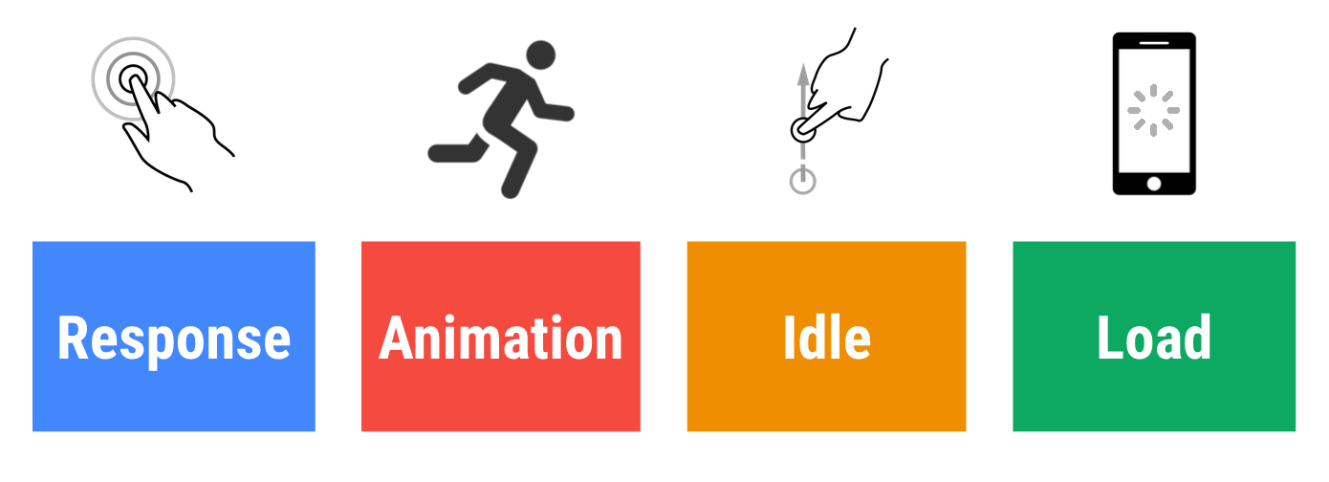
RAIL Model
Notes:
Response:

Slide 3

Как пользователи реагируют на задержки производительности
0мс
16мс
Notes:
Пользователи исключительно хорошо отслеживают движение, и им не нравится, когда анимация неплавная.
Анимация кажется им гладкой, если каждую секунду визуализируются 60 новых кадров.
Это 16 мс на кадр, включая время, необходимое браузеру для рисования нового кадра на экране, оставляя приложению около 10 мс для создания кадра.

Slide 4
Как пользователи реагируют на задержки производительности
0мс
16мс
100мс
Notes:
В течение этого временного окна необходимо ответить на действия пользователя, пользователям кажется, что результат мгновенный. Перейти эту черту, и связь между действием и реакцией (ответом) нарушится.

Slide 5

Как пользователи реагируют на задержки производительности
0мс
16мс
100мс
300мс
Notes:
Пользователи испытывают небольшую заметную задержку.

Slide 6

Как пользователи реагируют на задержки производительности
0мс
16мс
100мс
300мс
1000мс
Notes:
В рамках этого окна загрузка страницы и ее изменение кажется частью естественного и непрерывного процесса.

Slide 7

Как пользователи реагируют на задержки производительности
0мс
16мс
100мс
300мс
1000мс
10000мс
Notes:
После 1000 миллисекунд (1 секунда) пользователи теряют сосредоточенность на задаче, которую они выполняют.

Slide 8

Как пользователи реагируют на задержки производительности
0мс
16мс
100мс
300мс
1000мс
10000мс
Notes:
Пользователи разочарованы и могут покинуть страницу. Они могут вернуться или не вернуться позже.

Slide 9
Response
Response: respond in under 50ms
Complete a transition initiated by user input within 100ms. Users spend the majority of their time waiting for sites to respond to their input, not waiting for the sites to load.
Respond to user input within 50ms, or else the connection between action and reaction is broken. This applies to most inputs, such as clicking buttons, toggling form controls, or starting animations. This does not apply to touch drags or scrolls.
For actions that take longer than 50ms to complete, always provide feedback.
Notes:
Отвечайте на действия пользователя в пределах 100ms.
Пользователи проводят большую часть времени, в ожидании, когда сайт ответит на их запрос, а не когда сайт загружается.
Отвечайте пользователю в пределах 50 мс, иначе связь между действием и реакцией прервется
Если ответ на действие длится дольше 50 мс, всегда оставляйте feedback, (обратную связь, ответ)

Slide 10
Animation
Animation: produce a frame in 10ms
Produce each frame in an animation in 10ms or less.
Aim for visual smoothness. Users notice when frame rates vary.
Notes:
Для каждого кадра анимации у вас есть 10мс. Технически, максимум – 16мс (1000мс / 60fps), но браузеру нужно 6 мс для отрисовки каждого фрейма.
Стремитесь к визуальной гладкости. Пользователи замечают, когда меняется частота кадров

Slide 11
Idle
Idle: maximize idle time
Use idle time to complete deferred work
Notes:
Idle:
Use idle time to complete deferred work. For example, for the initial page load, load as little data as possible, then use idle time to load the rest.
Perform work during idle time in 50ms or less. Any longer, and you risk interfering with the app's ability to respond to user input within 50ms.
If a user interacts with a page during idle time work, the user interaction should always take the highest priority and interrupt the idle time work.

Slide 12
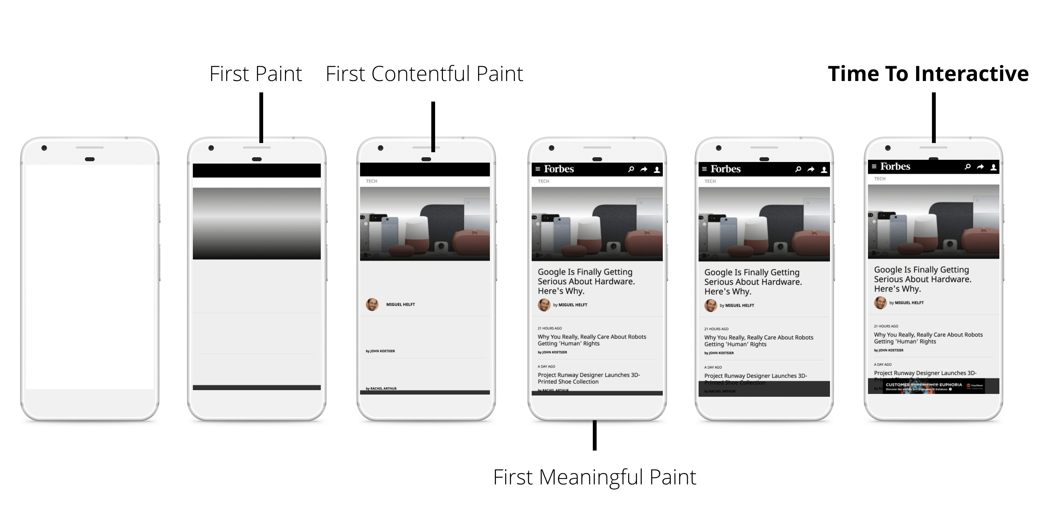
Load
Deliver content and become interactive in under 5 seconds
When pages load slowly, user attention wanders, and users perceive the task as broken. Sites that load quickly have longer average sessions, lower bounce rates, and higher ad viewability.
Notes:
Load
Test your load performance on the mobile devices and network connections that are common among your users. If your business has information on what devices and network connections your users are on, then you can use that combination and set your own loading performance targets.
Keep in mind that although your typical mobile user's device might claim that it's on a 2G, 3G, or 4G connection, in reality the effective connection speed is often significantly slower, due to packet loss and network variance.
Focus on optimizing the Critical Rendering Path to unblock rendering.
You don't have to load everything in under 5 seconds to produce the perception of a complete load. Enable progressive rendering and do some work in the background. Defer non-essential loads to periods of idle time.

Slide 13
Content optimization
The more web applications are growing in their scope, ambition, and functionality the more the amount of data downloaded by each application continues to increase at a steady pace. To deliver great performance we need to optimize delivery of each and every byte!

Slide 14
Content optimization
 | 50th percentile | 75th percentile | 90th percentile
HTML | 13 KB | 26 KB | 54 KB
Images | 528 KB | 1213 KB | 2384 KB
JavaScript | 207 KB | 385 KB | 587 KB
CSS | 24 KB | 53 KB | 108 KB
The trend in growth of number of downloaded bytes for popular destinations on the web between January 2013 and January 2014
Notes:
Unlike their desktop counterparts, web applications do not require a separate installation process: enter the URL and we are up and running -- that’s a key feature of the web. However, to make this happen we often have to fetch dozens, and sometime hundreds, of various resources, all of which can add up to megabytes of data and must come together in hundreds of milliseconds to facilitate the instant web experience we are aiming for.
Achieving an instant web experience in light of these requirements is no small feat, which is why optimizing content efficiency is critical: eliminating unnecessary downloads, optimizing transfer encoding of each resource through various compression techniques, and leveraging caching whenever possible to eliminate redundant downloads.

Slide 15
Content optimization
Eliminating Unnecessary Downloads
The fastest and best-optimized resource is a resource not sent. You should eliminate unnecessary resources from your application. It’s a good practice to question, and periodically revisit, the implicit and explicit assumptions with your team.
Too often, pages contain resources that are unnecessary, or worse, that hinder page performance without delivering much value to the visitor or to the site they're hosted on.
Notes:
Examples:
You've always included resource X on your pages, but does the cost of downloading and displaying it offset the value it delivers to the user? Can you measure and prove its value?
Does the resource (especially if it's a third-party resource) deliver consistent performance? Is this resource in the critical path, or need to be? If the resource is in the critical path, could it be a single point of failure for the site? That is, if the resource is unavailable, does it affect performance and the user experience of your pages?
Does this resource need or have an SLA? Does this resource follow performance best practices: compression, caching, and so on?
Site A has decided to display a photo carousel on its homepage to allow the visitor to preview multiple photos with a quick click. All of the photos are loaded when the page is loaded, and the user advances through the photos.
Question: Have you measured how many users view multiple photos in the carousel? You might be incurring high overhead by downloading resources that most visitors never view.
Site B has decided to install a third-party widget to display related content, improve social engagement, or provide some other service.
Question: Have you tracked how many visitors use the widget or click-through on the content that the widget provides? Is the engagement that this widget generates enough to justify its overhead?

Slide 16
Content optimization
Text resources optimization
Minification: preprocessing & context-specific optimizations
Deletion of code comments (CSS (/* … */), HTML (<!-- … -->), and JavaScript (// …))
Collapsing the few CSS-rules into one without affecting any other styles, saving more bytes with a CSS-compressor.
Deletion of whitespaces (spaces and tabs)

Slide 17
Content optimization
<html> <head> <style> /* awesome-container is only used on the landing page */ .awesome-container { font-size: 120% } .awesome-container { width: 50% } </style> </head> <body> <!-- awesome container content: START --> <div>…</div> <!-- awesome container content: END --> <script> awesomeAnalytics(); // beacon conversion metrics </script> </body> </html>

Slide 18
Content optimization
<html><head><style>.awesome-container{font-size:120%;width: 50%} </style></head><body><div>…</div><script>awesomeAnalytics(); </script></body></html>

Slide 19
Content optimization
Text compression with GZIP
Compression ratio from 60 to 88%
Supported by all modern browsers
Notes:
GZIP is a generic compressor that can be applied to any stream of bytes. Under the hood, it remembers some of the previously seen content and attempts to find and replace duplicate data fragments in an efficient way

Slide 20
Image optimization
Optimizing vector images
SVG files should be minified to reduce their size
SVG files should be compressed with GZIP
Notes:
Prefer vector formats: vector images are resolution and scale independent, which makes them a perfect fit for the multi-device and high-resolution world.

Slide 21
Image optimization
Optimizing raster images
Selecting the right image format

Slide 22
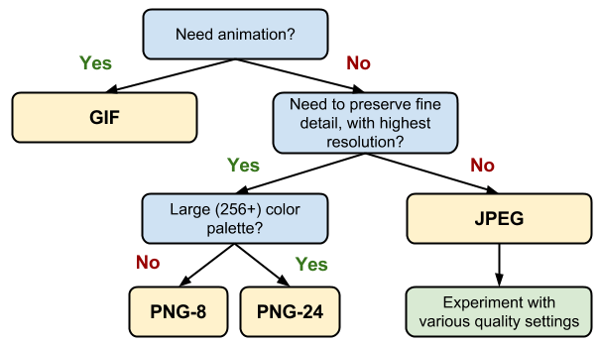
Image optimization

Slide 23
Image optimization
Tools
gifsicle
jpegtran
optipng
pngquant
Notes:
gifsicle - create and optimize GIF images
jpegtran - optimize JPEG images
optipng - lossless PNG optimization
pngquant - lossy PNG optimization

Slide 24
Image optimization
Choose the right size
Delivering scaled assets is one of the simplest and most effective optimizations
Pay close attention to large assets as they result in high overhead
Reduce the number of unnecessary pixels by scaling your images to their display size
graph of unnecessary pixels
Screen resolution | Natural size | Display size (CSS px) | Unnecessary pixels
1x | 110 x 110 | 100 x 100 | 110 x 110 - 100 x 100 = 2100
1x | 410 x 410 | 400 x 400 | 410 x 410 - 400 x 400 = 8100
1x | 810 x 810 | 800 x 800 | 810 x 810 - 800 x 800 = 16100
2x | 220 x 220 | 100 x 100 | 210 x 210 - (2 x 100) x (2 x 100) = 8400
2x | 820 x 820 | 400 x 400 | 820 x 820 - (2 x 400) x (2 x 400) = 32400
2x | 1620 x 1620 | 800 x 800 | 1620 x 1620 - (2 x 800) x (2 x 800) = 64400

Slide 25
Web font optimization
Webfont formats
EOT, TTF, WOFF, and WOFF2
Serve WOFF 2.0 variant to browsers that support it.
Serve WOFF variant to the majority of browsers.
Serve TTF variant to old Android (below 4.4) browsers.
Serve EOT variant to old IE (below IE9) browsers.

Slide 26
Web font optimization
Reducing font size with compression
EOT and TTF formats are not compressed by default. Only GZIP helps.
WOFF has built-in compression.
WOFF2 uses custom preprocessing and compression algorithms to deliver ~30% file-size reduction over other formats.

Slide 27
Web font optimization
Defining a font family with @font-face
@font-face { font-family: 'Awesome Font'; font-style: normal; font-weight: 400; src: local('Awesome Font'), url('/fonts/awesome.woff2') format('woff2'), url('/fonts/awesome.woff') format('woff'), url('/fonts/awesome.ttf') format('truetype'), url('/fonts/awesome.eot') format('embedded-opentype'); } @font-face { font-family: 'Awesome Font'; font-style: italic; font-weight: 400; src: local('Awesome Font Italic'), url('/fonts/awesome-i.woff2') format('woff2'), url('/fonts/awesome-i.woff') format('woff'), url('/fonts/awesome-i.ttf') format('truetype'), url('/fonts/awesome-i.eot') format('embedded-opentype'); }
Notes:
The @font-face CSS at-rule allows you to define the location of a particular font resource, its style characteristics, and the Unicode codepoints for which it should be used. A combination of such `@font-face declarations can be used to construct a "font family," which the browser will use to evaluate which font resources need to be downloaded and applied to the current page.
The local() directive allows you to reference, load, and use locally installed fonts.
The url() directive allows you to load external fonts, and are allowed to contain an optional format() hint indicating the format of the font referenced by the provided URL.

Slide 28
Web font optimization
@font-face { font-family: 'Awesome Font'; font-style: normal; font-weight: 400; src: local('Awesome Font'), url('/fonts/awesome-l.woff2') format('woff2'), url('/fonts/awesome-l.woff') format('woff'), url('/fonts/awesome-l.ttf') format('truetype'), url('/fonts/awesome-l.eot') format('embedded-opentype'); unicode-range: U+000-5FF; /* Latin glyphs */ } @font-face { font-family: 'Awesome Font'; font-style: normal; font-weight: 400; src: local('Awesome Font'), url('/fonts/awesome-jp.woff2') format('woff2'), url('/fonts/awesome-jp.woff') format('woff'), url('/fonts/awesome-jp.ttf') format('truetype'), url('/fonts/awesome-jp.eot') format('embedded-opentype'); unicode-range: U+3000-9FFF, U+ff??; /* Japanese glyphs */ }
Unicode-range subsetting
Notes:
In addition to font properties such as style, weight, and stretch, the @font-face rule allows us to define a set of Unicode codepoints supported by each resource. This enables us to split a large Unicode font into smaller subsets (for example, Latin, Cyrillic, and Greek subsets) and only download the glyphs required to render the text on a particular page.
Single codepoint (for example, U+416)
Interval range (for example, U+400-4ff): indicates the start and end codepoints of a range
Wildcard range (for example, U+4??): ? characters indicate any hexadecimal digit

Slide 29
Web font optimization
Optimizing loading and rendering
<link rel="preload">
Notes:
Caution: Using <link rel="preload"> will make an unconditional, high-priority request for the Webfont's URL, regardless of whether it actually ends up being needed on the page. If there's a reasonable chance that the remote copy of the Webfont won't be needed—for instance, because the @font-face definition includes a local() entry for a common font like Roboto—then using <link rel="preload"> will result in a wasted request. Some browsers will display a warning in their Developer Tools Console when a resource is preloaded but not actually used.

Slide 30
Web font optimization
Font loading
Chrome and Firefox have a three second timeout after which the text is shown with the fallback font. If the font manages to download, then eventually a swap occurs and the text is re-rendered with the intended font.
Internet Explorer has a zero second timeout which results in immediate text rendering. If the requested font is not yet available, a fallback is used, and text is re-rendered later once the requested font becomes available.
Safari has no timeout behavior (or at least nothing beyond a baseline network timeout).

Slide 31
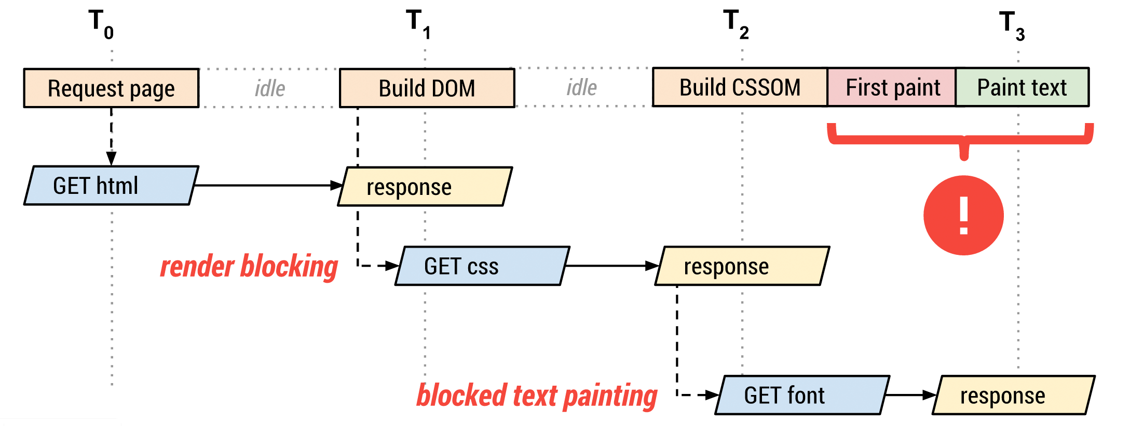
Web font optimization
Font loading process
Notes:
The browser requests the HTML document.
The browser begins parsing the HTML response and constructing the DOM.
The browser discovers CSS, JS, and other resources and dispatches requests.
The browser constructs the CSSOM after all of the CSS content is received and combines it with the DOM tree to construct the render tree.
Font requests are dispatched after the render tree indicates which font variants are needed to render the specified text on the page.
The browser performs layout and paints content to the screen.
If the font is not yet available, the browser may not render any text pixels.
After the font is available, the browser paints the text pixels.

Slide 32
Web font optimization
The font display timeline
Similar to the existing font timeout behaviors that some browsers implement today, font-display segments the lifetime of a font download into three major periods:
The first period is the font block period. During this period, if the font face is not loaded, any element attempting to use it must instead render with an invisible fallback font face. If the font face successfully loads during the block period, the font face is then used normally.
The font swap period occurs immediately after the font block period. During this period, if the font face is not loaded, any element attempting to use it must instead render with a fallback font face. If the font face successfully loads during the swap period, the font face is then used normally.
The font failure period occurs immediately after the font swap period. If the font face is not yet loaded when this period starts, it’s marked as a failed load, causing normal font fallback. Otherwise, the font face is used normally.

Slide 33
Web font optimization
font-display
@font-face { font-family: 'Awesome Font'; font-style: normal; font-weight: 400; font-display: auto; /* or block, swap, fallback */ src: local('Awesome Font'), url('/fonts/awesome-l.woff2') format('woff2'), /* will be preloaded */ url('/fonts/awesome-l.woff') format('woff'), url('/fonts/awesome-l.ttf') format('truetype'), url('/fonts/awesome-l.eot') format('embedded-opentype'); unicode-range: U+000-5FF; /* Latin glyphs */ }
Notes:
auto uses whatever font display strategy the user-agent uses. Most browsers currently have a default strategy similar to block.
block gives the font face a short block period (3s is recommended in most cases) and an infinite swap period. In other words, the browser draws "invisible" text at first if the font is not loaded, but swaps the font face in as soon as it loads. To do this the browser creates an anonymous font face with metrics similar to the selected font but with all glyphs containing no "ink." This value should only be used if rendering text in a particular typeface is required for the page to be usable.
swap gives the font face a zero second block period and an infinite swap period. This means the browser draws text immediately with a fallback if the font face isn’t loaded, but swaps the font face in as soon as it loads. Similar to block, this value should only be used when rendering text in a particular font is important for the page, but rendering in any font will still get a correct message across. Logo text is a good candidate for swap since displaying a company’s name using a reasonable fallback will get the message across but you’d eventually use the official typeface.
fallback gives the font face an extremely small block period (100ms or less is recommended in most cases) and a short swap period (three seconds is recommended in most cases). In other words, the font face is rendered with a fallback at first if it’s not loaded, but the font is swapped as soon as it loads. However, if too much time passes, the fallback will be used for the rest of the page’s lifetime. fallback is a good candidate for things like body text where you’d like the user to start reading as soon as possible and don’t want to disturb their experience by shifting text around as a new font loads in.
optional gives the font face an extremely small block period (100ms or less is recommended in most cases) and a zero second swap period. Similar to fallback, this is a good choice for when the downloading font is more of a "nice to have" but not critical to the experience. The optional value leaves it up to the browser to decide whether to initiate the font download, which it may choose not to do or it may do it as a low priority depending on what it thinks would be best for the user. This can be beneficial in situations where the user is on a weak connection and pulling down a font may not be the best use of resources.

Slide 34
Web font optimization
The Font Loading API
var font = new FontFace("Awesome Font", "url(/fonts/awesome.woff2)", { style: 'normal', unicodeRange: 'U+000-5FF', weight: '400' }); // don't wait for the render tree, initiate an immediate fetch! font.load().then(function() { // apply the font (which may re-render text and cause a page reflow) // after the font has finished downloading document.fonts.add(font); document.body.style.fontFamily = "Awesome Font, serif"; // OR... by default the content is hidden, // and it's rendered after the font is available var content = document.getElementById("content"); content.style.visibility = "visible"; // OR... apply your own render strategy here... });
Notes:
Further, because you can check the font status (via the check()) method and track its download progress, you can also define a custom strategy for rendering text on your pages:
You can hold all text rendering until the font is available.
You can implement a custom timeout for each font.
You can use the fallback font to unblock rendering and inject a new style that uses the desired font after the font is available.
Best of all, you can also mix and match the above strategies for different content on the page. For example, you can delay text rendering on some sections until the font is available, use a fallback font, and then re-render after the font download has finished, specify different timeouts, and so on.

Slide 35
HTTP Caching
E-tag
The server uses the ETag HTTP header to communicate a validation token.
The validation token enables efficient resource update checks: no data is transferred if the resource has not changed.
Notes:
На сервере генерируется специальный маркер, который отдаётся в заголовке вместе с ресурсом. При новом запросе (когда время жизни кеша истекло) браузер отправляет этот маркер на сервер (заголовок "If-None-Match"). В случае, если ресурс не изменился, то приходит ответ с кодом 304, и скачивать ничего не надо.
Все, что нам нужно сделать, - проверить, действительно ли сервер отправляет нужные маркеры ETag.

Slide 36
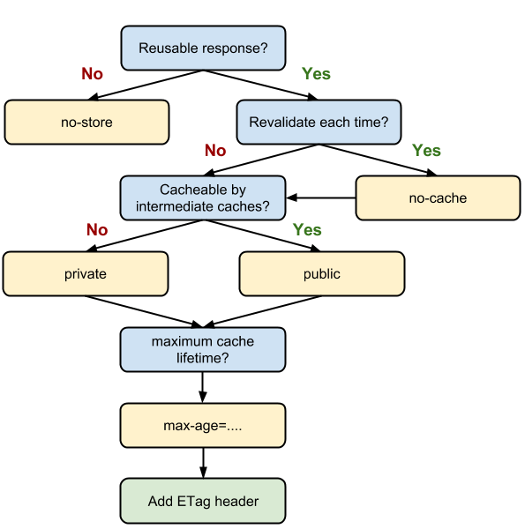
Cache-Control
Notes:
Each resource can define its caching policy via the Cache-Control HTTP header.
Cache-Control directives control who can cache the response, under which conditions, and for how long.
no-store It simply disallows the browser and all intermediate caches from storing any version of the returned response

Slide 37
мы посмотрели rail model, оптимизация загрузки ресурсов (content optimization), есть render optimization

Slide 38
Questions?

